Slide 1
The DAISY Award for Extraordinary Nurses
Notes:
*Welcome everyone to the DAISY presentation and let them know that you are excited to celebrate an Honoree today

Slide 2
What is the Daisy Award?
The Daisy Award, created in honor of Patrick Barnes, allows patients and patients’ families to recognize extraordinary nurses and the contributions that they make every day.
A few days after Patrick Barnes death, his wife came up with the acronym, DAISY, standing for Disease Attacking the Immune System. His family established the award nationally for Extraordinary Nurses to be recognized.
Individuals who have been chosen as a result of their exceptional care, compassion, and dedication to their patients and their profession.

Slide 3
Congratulations to our 24 nominees
Residential
Jenny Fisher- Oconomowoc
Hallie Hartman- Brown Deer
Morgan Luedtke- Oconomowoc
Admissions RNs
Jill Beaty
Inpatient
Abby Bilas- West Allis
Maggie Nielson- West Allis
Eve Brown- West Allis
Ernest Colburn- West Allis
Alex Rolph- West Allis
Robyn Schultz- West Allis
Erionna Smith- West Allis
Melissa Hansen- Brown Deer
Alexis Mitchell- Brown Deer
Kelsey Minton- Brown Deer
Barbarah Kibrige- Brown Deer
Ashley Schwoegler- Oconomowoc
Alexander Widenski- Oconomowoc
PHP/IOP
Jennifer Allen –Tampa
Tiffany Capouch – St. Paul
Jessica DiGregoria – Hinsdale
Amanda VonFeldt- Minneapolis
Yakini Moseley –Atlanta
Angelica Murrenus- Brown Deer
Maria Vegiuela- Miami

Slide 4
Committee Review Process
Rogers internal committee consists of 17 members all from various disciplines.
Voting Process:
Information related to employee name, location and programs are removed from the nomination.
The team is asked to vote for their top 5
Re-vote as needed to narrow down the top three.

Slide 5
Nomination story (3rd Place)-Peer Nomination Jill Beaty-Oconomowoc Admissions
Jill Beaty is the glue that holds so many things together both for admissions as well as any RN needs. She is well liked and trusted by not only her Rogers Co-workers in admissions, the units, and by providers but also by staff from other organizations (Children’s WI, OMH, Mansfield, Waukesha Mem, primary care, groups from across the country, etc). Outside organizations know Jill by name and they ask for her directly. She is an exemplary employee and puts her heart into every patient and family she works with. I have countless examples of how Jill has gone above and beyond to allow patients access to care. A recent example is a Rogers patient that was sent out for medical clearance and there was confusion from the ER on the patient transfer back to Rogers. The ER was getting frustrated, but Jill worked with the ER and all 3 campuses to find this patient a bed immediately. Another example was a patient over at Children’s WI that was hospitalized for an eating disorder. The patient had many complex symptoms, so Jill worked with Children’s WI staff and Rogers providers to ensure a quick transfer to Rogers. Every day Jill navigates difficult and complex patient situations to allow patients to access any level of care at Rogers. Jill is also actively engaged in improvement projects and is always looking to improve the patient/family experience. I have worked with Jill in many ways during my time at Rogers and I am always impressed at her ethics, hard work, passion, and heart.
Notes:
*Please tell the nomination story, or if nominator is present, invite them to do so. [Don’t read slide text word for word]

Slide 6
Nomination; patient story (2nd place) Alexis Mitchell-Brown Deer Inpatient
I was inpatient at Rogers for two weeks and throughout this time I was blessed to meet the world’s coolest nurse, Alexis. My last night at Rogers was very difficult for me because my depression was still so heavy. I was honestly afraid of how I would be able to survive and continue my life outside of the hospital because my dark thoughts can be so intense. Alexis took a considerable amount of time to sit with me and have a very important conversation with me. She helped me so much that night even though I wasn’t technically on her patients list for the night. The compassion, caring, and understanding that Alexis demonstrated during my stay at Rogers was truly amazing. I literally don’t have enough words to describe how much her care meant to me. I have had experience with many different staff members through inpatient stays and I have never met someone so hardworking and genuinely caring. It is so obvious how much she puts her heart into her job, and it is wonderful. The world needs more people like Alexis! It takes a very strong person to do the job she does, and she is perfect for that role. Even when she works long hours, she is still able to deliver genuine care and compassion to every patient. I genuinely don’t know if I would have had the ability to make a safe choice when I left the hospital without her powerful words and care. Alexis, thank you for saving my life. I am able to find a spark of hope in the words that she spoke to me. Through the battle of depression, it can be hard to see the value in yourself. Alexis gave me some important reminders of just how valuable my life is. I will let those words help me to continue to push through life even though it is so very hard.
Notes:
*Please tell the nomination story, or if nominator is present, invite them to do so. [Don’t read slide text word for word]

Slide 7
Nomination; patient’s own words : WINNER! Amanda VonFeldt-Minneapolis PHP
Amanda made herself very approachable just from my beginning intake. I felt very comfortable around her and she was always available when I needed her. She made sure to help me understand how my medical health is also as important as my mental health and was able to get me to understand how I need to take care of myself physically. When I needed urgent outside medical care, she made sure that she had all the paperwork ready to go for the clinic and she made sure to call ahead to the clinic so that everyone was on the same page on what is going on and really stressed to the providers on how she would like there to be communication after the visit. This doesn’t happen too often. The amount of energy and work that Amanda put in to make sure that the medical transfer of care was smooth and that everyone was informed was more than I’ve seen from any other nurse in any other program. She is very good at addressing both the physical and mental health concerns in a kind and compassionate way and really comes from a place of understanding. My treatment would not be as successful as it was without her being a part of my treatment team. I was able to address important concerns that I didn’t feel comfortable with anyone else
Notes:
*Please tell the nomination story, or if nominator is present, invite them to do so. [Don’t read slide text word for word]

Slide 8
Congratulations!
Amanda Von Feldt work in Minneapolis at our PHP/IOP programs.
Notes:
*After you share the name, you may wish to stop sharing your screen and encourage everyone to clap or celebrate the Honoree!

Slide 10
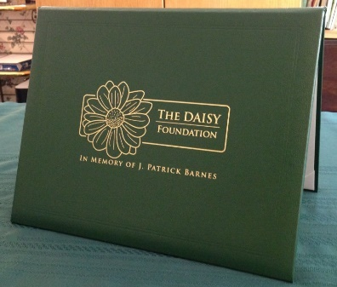
Portfolio and award pin
Notes:
Your certificate is placed in the green DAISY Foundation portfolio for you. You also have received a special DAISY Honoree pin for your badge. The pin was created because while Patrick was ill, his Stepmother, Bonnie, noticed the great tradition nurses have for pins. The DAISY Foundation hopes you will wear your DAISY Honoree Pin proudly

Slide 11
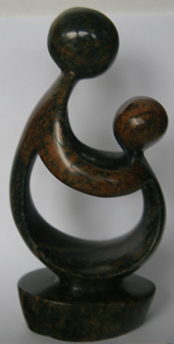
“Healer’s Touch” sculpture
Hand carved in Zimbabwe!
Artists’ video on DAISY website to learn more:
DAISYfoundation.org
Notes:
*If the Honoree has received their gifts, you may want to stop sharing your screen and allow the honoree to hold up the sculpture as you explain its meaning.
The DAISY foundation wants you to have this sculpture as a symbol of your recognition today. It is called A Healer’s Touch. Each piece is hand carved by the artists of the Shona Tribe in Zimbabwe. The DAISY Foundation chose this beautiful design not only because it sensitively depicts the unique relationship nurses have with their patients and teachers have with their students, but also because the Shona people hold their healers in a position of great importance to the community and feel about their traditional healers the way The DAISY Foundation feels about nurses and those who education them: they are treasures to their community. As you may know, the economy and politics of Zimbabwe have been in turmoil for decades, and the artists are able to support hundreds of people in their families with this work.

Slide 12
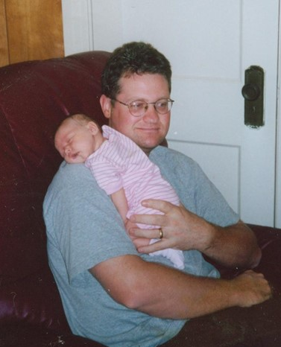
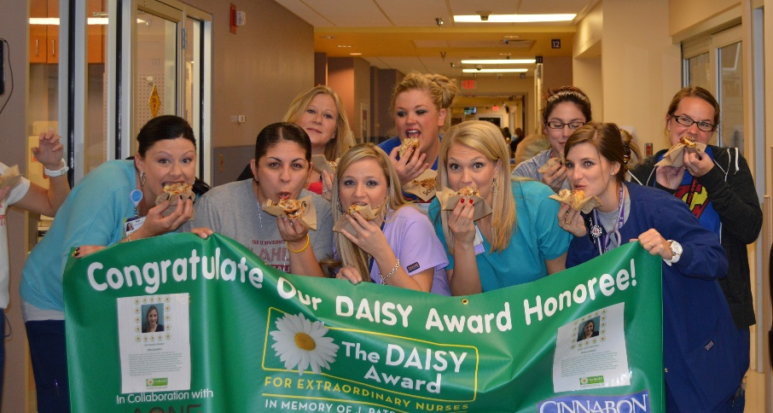
Cinnamon rolls
Notes:
*Explain how cinnamon rolls will be provided to the honoree's unit
*Share the message from DAISY about why we have cinnamon rolls at every presentation:
There are several reasons why The DAISY Foundation asks that cinnamon rolls be served at DAISY celebrations. First, when Pat was ill, he had lost his appetite until one morning, when he asked for a bite of a cinnamon roll that his Dad had brought for his own breakfast. Pat ended up eating the whole thing! As his family was leaving that evening, Pat asked that they bring him a cinnamon roll the next day and to be sure to bring in enough for all his nurses. Those cinnamon rolls were Pat’s ‘thank you’ to his nurses, and the Foundation wants all nurses to share in his favorite treat as a gift of gratitude. Secondly, nursing is a real ‘team sport,’ the cinnamon rolls serve to celebrate your team and give you an opportunity to stop for a few minutes and share something special together.
Finally, almost without exception, when a nurse receives The DAISY Award, the humble response is, ‘I didn’t do anything special. I was just doing my job.’ What the DAISY Nurse may not realize, however, is that when nurses are ‘just doing their jobs,’ they have such an important and meaningful impact on the lives of so many. DAISY hopes that whenever you smell or taste a cinnamon roll or bake with cinnamon you will be reminded how special you are and the positive difference you are making in a patient’s and/or their family’s life. You are making the world a better place because you are a nurse, and we and The DAISY Foundation both salute you and honor you.

Slide 13
Banner
The DAISY banner will be hung on your unit until the next celebration takes place
Notes:
*if you have any special traditions with your banner, like having the Honoree sign it or putting up their name and story, let them know!

Slide 14
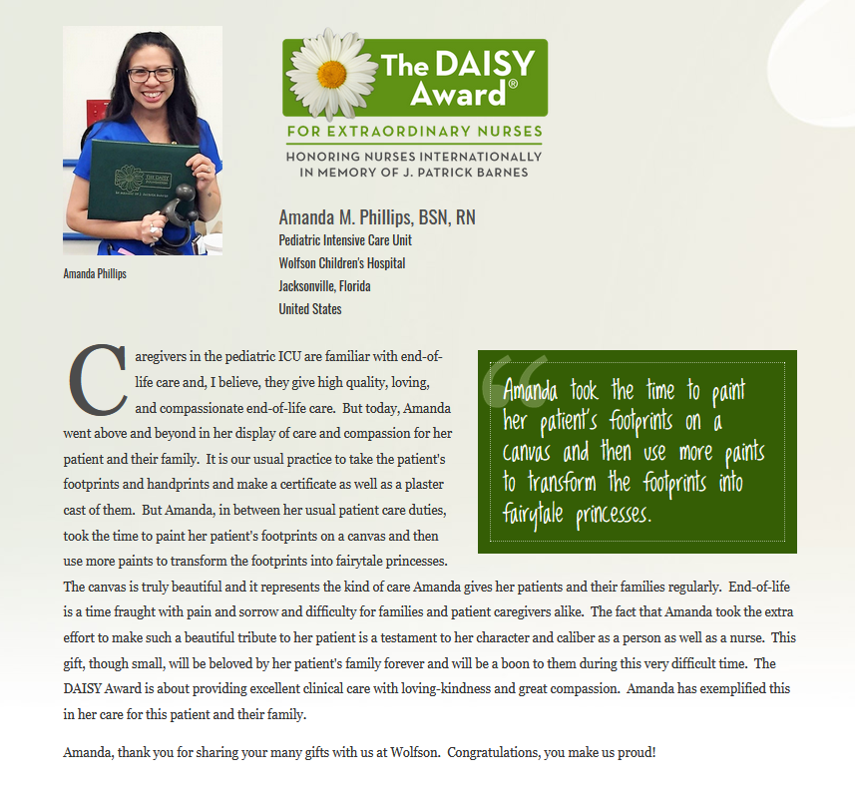
Online spotlight
You will be registered with The DAISY Foundation on their website. A special page will be created for you to share with your friends and family.
A list of your additional benefits can be found in your gift bag, or online at DAISYfoundation.org
Notes:
*Read Slide
*Invite the honoree to send in a picture for their online spotlight
*let them know if you will be sharing their story on social media, in the facility, etc.

Slide 15
Thank you
Thank you to all our patients and staff who have taken the time to nominate a nurse for their compassionate and extraordinary care that they deliver.
This award does not happen unless people take the time to submit a nomination story, and it means a great deal that you care enough to do so.
Our next ceremony will be sometime in April.
Notes:
Thank the Nominator (if present) - if not, delete slide. [Don’t read slide text word for word]

Slide 16
Nurses make a difference!
Thank you to all nurses on the Rogers team for choosing nursing as a career. Thank you for the skill, care, and compassion you give to your patients every day.
Thank you for helping to make a difference in one of our patient’s or residents' lives.
Notes:
*Read slide then ask the Honoree if they would like to share a few words. If so, stop sharing your screen so everyone can see her/him.

