Slide 1
The DAISY Award for Extraordinary Nurses
Notes:
*Welcome everyone to the DAISY presentation and let them know that you are excited to celebrate an Honoree today

Slide 2
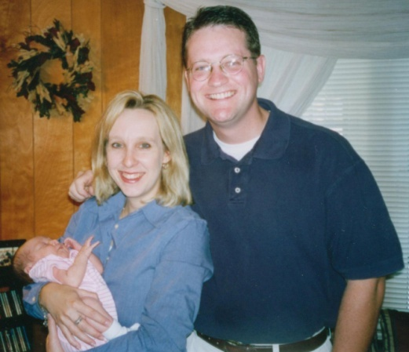
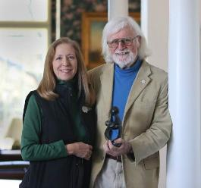
About The DAISY Foundation
J. Patrick Barnes (Pat)
Tena and Pat (and baby Riley)
Bonnie and Mark
Diseases
Attacking the
Immune
SYstem
The DAISY Foundation™
Notes:
I’d like to start the presentation with some background on The DAISY Foundation and why we are all here today
*Click and the slide should begin playing automatically, explaining the history of the Foundation

Slide 3
Nomination story (In our patient’s words)
This nurse is my hero, who gave me the skill and lessons to get me where I am in my recovery today. During treatment I had many distressing emotions, as not only was my body changing, but so was my mind adjusting to a new lifestyle. I will forever be grateful for her caring, empathetic and understanding heart. Our daily check ins were the highlight of my night; I gained the support I needed for healing and was able to process my emotions with staff guidance.
When I say that this nurse has been there from the beginning, it’s the truth, from CAU to CAED she provided a non-judgmental listening ear for me to open up and express my feelings during our check ins. I felt safe talking to her, she was always honest with her communication and her expertise in nursing allowed for impactful guidance. This nurse was extremely patient with me every time I cried, when I was feeling hopeless and want to give up on myself during treatment, I could not have finished out treatment without her compassionate heart.
Lastly, this nurse's personality is something that I will never forget, she is funny, relatable, down to earth, where you are in your recovery, she will be there to meet you where you are and lead you to the path to excellence even it that means sitting on the bathroom floor together after a long hard day.
Notes:
*Please tell the nomination story, or if nominator is present, invite them to do so. [Don’t read slide text word for word]

Slide 4
Congratulations!
Elizabeth (Liz) Komp RN.
Liz works on the Child and Adolescent Eating Disorder Unit.
Notes:
*After you share the name, you may wish to stop sharing your screen and encourage everyone to clap or celebrate the Honoree!

Slide 5
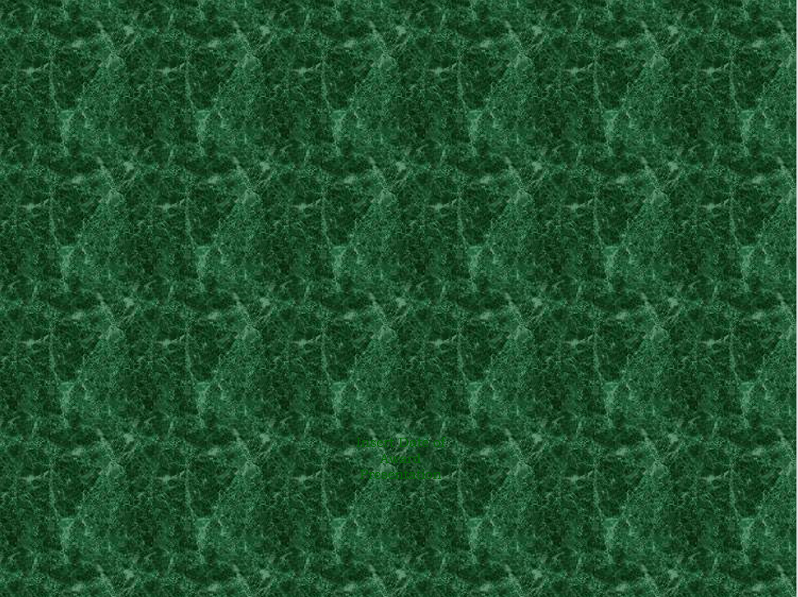
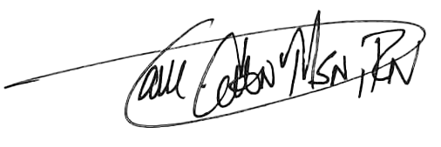
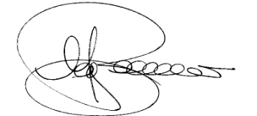
The DAISY Award For
Extraordinary Nurses
This Award is presented to
Elizabeth Komp, RN
In deep appreciation of all you do,
who you are, and the incredibly meaningful difference you make in the lives of so many people
Terri Cohn, MSN, RN
Chief Nursing Officer
September 2022
J. Mark Barnes, FAAN
Co-Founder, Chairman
In collaboration with
Notes:
The first item you have received is a certificate- it reads “The DAISY Award for Extraordinary Nurses. This Award is presented to (HONOREEE NAME) In deep appreciation of all you do, who you are, and the incredibly meaningful difference you make in the lives of so many people”

Slide 6
Portfolio and award pin
Notes:
Your certificate is placed in the green DAISY Foundation portfolio for you. You also have received a special DAISY Honoree pin for your badge. The pin was created because while Patrick was ill, his Stepmother, Bonnie, noticed the great tradition nurses have for pins. The DAISY Foundation hopes you will wear your DAISY Honoree Pin proudly

Slide 7
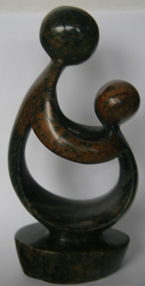
“Healer’s Touch” sculpture
Hand carved in Zimbabwe!
Artists’ video on DAISY website to learn more:
DAISYfoundation.org
Notes:
*If the Honoree has received their gifts, you may want to stop sharing your screen and allow the honoree to hold up the sculpture as you explain its meaning.
The DAISY foundation wants you to have this sculpture as a symbol of your recognition today. It is called A Healer’s Touch. Each piece is hand carved by the artists of the Shona Tribe in Zimbabwe. The DAISY Foundation chose this beautiful design not only because it sensitively depicts the unique relationship nurses have with their patients and teachers have with their students, but also because the Shona people hold their healers in a position of great importance to the community and feel about their traditional healers the way The DAISY Foundation feels about nurses and those who education them: they are treasures to their community. As you may know, the economy and politics of Zimbabwe have been in turmoil for decades, and the artists are able to support hundreds of people in their families with this work.

Slide 8
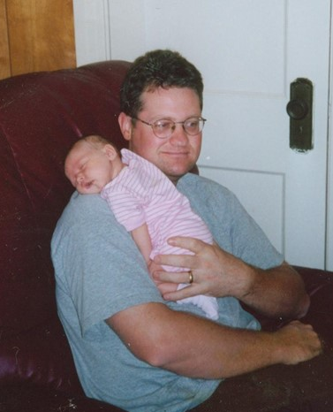
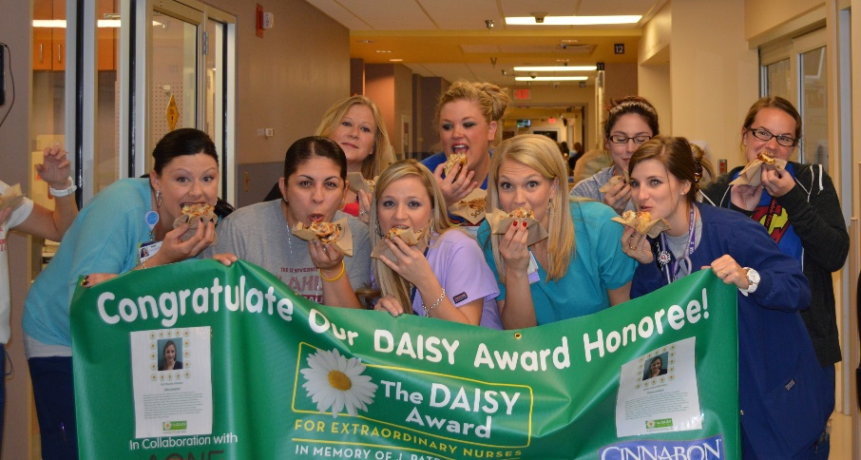
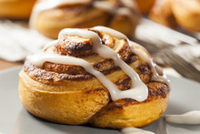
Cinnamon rolls
Notes:
*Explain how cinnamon rolls will be provided to the honoree's unit
*Share the message from DAISY about why we have cinnamon rolls at every presentation:
There are several reasons why The DAISY Foundation asks that cinnamon rolls be served at DAISY celebrations. First, when Pat was ill, he had lost his appetite until one morning, when he asked for a bite of a cinnamon roll that his Dad had brought for his own breakfast. Pat ended up eating the whole thing! As his family was leaving that evening, Pat asked that they bring him a cinnamon roll the next day and to be sure to bring in enough for all his nurses. Those cinnamon rolls were Pat’s ‘thank you’ to his nurses, and the Foundation wants all nurses to share in his favorite treat as a gift of gratitude. Secondly, nursing is a real ‘team sport,’ the cinnamon rolls serve to celebrate your team and give you an opportunity to stop for a few minutes and share something special together.
Finally, almost without exception, when a nurse receives The DAISY Award, the humble response is, ‘I didn’t do anything special. I was just doing my job.’ What the DAISY Nurse may not realize, however, is that when nurses are ‘just doing their jobs,’ they have such an important and meaningful impact on the lives of so many. DAISY hopes that whenever you smell or taste a cinnamon roll or bake with cinnamon you will be reminded how special you are and the positive difference you are making in a patient’s and/or their family’s life. You are making the world a better place because you are a nurse, and we and The DAISY Foundation both salute you and honor you.

Slide 9
Banner
The DAISY banner will be hung on your unit until the next celebration takes place
Notes:
*if you have any special traditions with your banner, like having the Honoree sign it or putting up their name and story, let them know!

Slide 10
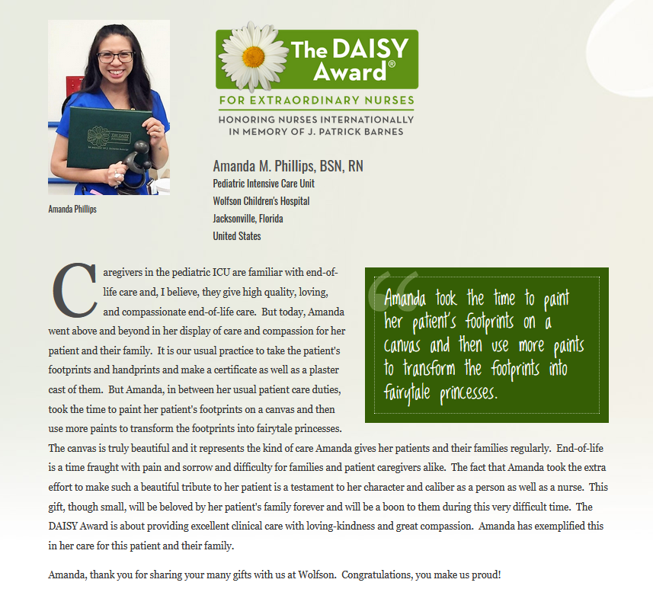
Online spotlight
You will be registered with The DAISY Foundation on their website. A special page will be created for you to share with your friends and family.
A list of your additional benefits can be found in your gift bag, or online at DAISYfoundation.org
Notes:
*Read Slide
*Invite the honoree to send in a picture for their online spotlight
*let them know if you will be sharing their story on social media, in the facility, etc.

Slide 11
Congratulations to our nominees
Mary Beth Alteri
Shannon Basile
Traci Bates
Jill Beaty
Marisa Beffel
Kristine Brandt
Deborah Clemens
Miranda Dooley
Nicole Dunnigan
Amanda Espenscheid
Nadine Farago
Jenny Fischer
Linda Fraser
Amanda Griffin
Morgan Gruszynski
Megan Haas
Brian Hansen
Hallie Hartmann
Shelli Hoffstrom
Charlotte Hopkins
Amy Kuecherer
Khoi Le
Jackie Loomis
Sommer Lovett
LaTrissa Luckett
Alyse Mandella
Kayla Mandt
Sarah Merabet
Christy Meyer
Kelsey Minton
Jessie Mitchell
Yakini Moseley
Stella Nader
Sierra Neu
Jennifer Petersen
Ani Potts
Molly Reid
Nicole Rintelman
Nicole Sabish
Theresa Sabol
Elise Schuh
Robyn Schultz
Joe Schultz
Ashley Schwoegler
Clifford Searl
Jayme Servia
Amanda Simpson
Jan Smith
Leah Stroede
Lisa Texeira
Maria Veiguela
Aarika Winter
Molly Wissler
Amanda Wolf
Denay Wood
Kimberly Young
Danielle York
Notes:
*read nominee names and let them know they will be receiving a DAISY nominee pin. Will receive a certificate in the mail, a pin and a copy of the nomination that was made

Slide 12
Thank you
Thank you to all our patients and staff who have taken the time to nominate a nurse for their compassionate and extraordinary care that they deliver. This award does not happen unless people take the time to submit a nomination story, and it means a great deal that you care enough to do so. Our next Daisy award will be given sometime in the month of December. We will be taking nominations through November 11.
Notes:
Thank the Nominator (if present) - if not, delete slide. [Don’t read slide text word for word]

Slide 13
Conclusion
Thank you to all nurses on the Roger’s team for choosing nursing as a career. Thank you for the skill, care and compassion you give to your patients every day.
Thank you for helping to make a difference in one of our patient’s or residents' lives.
Notes:
*Read slide then ask the Honoree if they would like to share a few words. If so, stop sharing your screen so everyone can see her/him.

