Slide 1
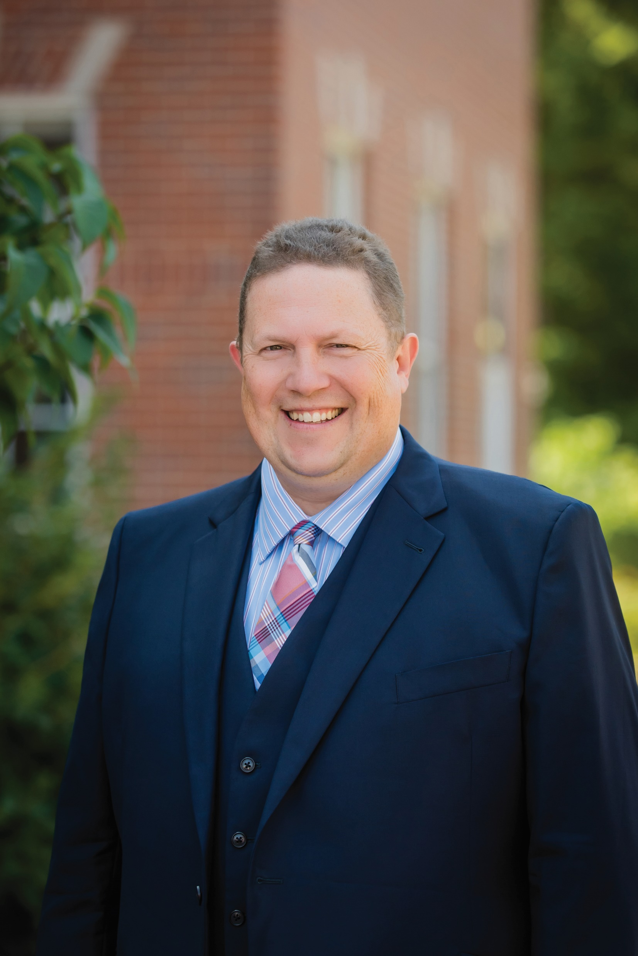
2022-2023 Scholarship
Are you a Rogers employee working a minimum of 32 hours per week for a minimum of 6 months, or the immediate family member of such an employee?
Are you currently working toward a degree that can be used in the behavioral health field?
Could you use $1,000 to help pay for education?
If you answered “yes” to the above questions, then the
ROGERS SCHOLARSHIP IS PERFECT FOR YOU!
This year’s scholarship is in honor of
Jerry Halverson, MD, Chief Medical Officer
Apply today!
Pick up an application from the medical staff office or on the Rogers intranet.
Complete the application and send to the medical staff office.
Applications will be reviewed for eligibility
TWO (2) winners will be selected from all eligible applications
Winners will receive a letter of notification
$1000 will be sent directly to the recipient.
Please note: Applications must be received by September 30, 2022 to the Medical Staff Office (elizabeth.luker@rogersbh.org & nancy.gulland@rogersbh.org)

