Slide 1
PA Hands of Thanks

Slide 2
Jordan W

Slide 3
Tonya S Tonya’s Turkey is trying to avoid the feast festivities by dressing as a cow! I am grateful for: The grace our team shows on another. The consistent collaboration and teamwork we exemplify. Time with loved ones.

Slide 4
Steph D Steph is grateful for her family.

Slide 5
Missi

Slide 6
Sam W I am thankful for my family (who loves the Green Bay Packers!)

Slide 7
Elle

Slide 8
Ang

Slide 9
Ashley I am thankful for my family and clearly, my cat!

Slide 10
Erin

Slide 11
Holly and her daughter I am thankful for all the fun trips I was able to take this year with family and friends.

Slide 12
Maggie

Slide 13
Katie

Slide 14
Liz C and daughter I am thankful for friends, family, health and per daughter..Greys Anatomy!

Slide 15
Mantha I am thankful for my family, fiancé, our dog and all the opportunities I was given.

Slide 16
Nicole

Slide 17
Sierra

Slide 18
Taylor

Slide 19
Missi’s Cat - Morris

Slide 20
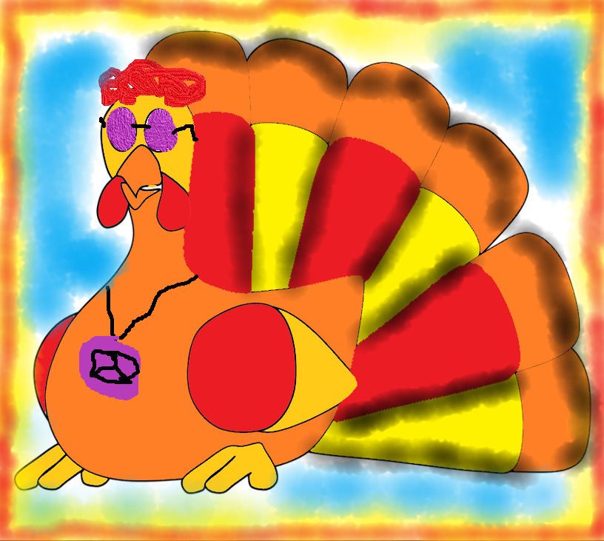
Chelsea I am grateful for my family and best fur friend, Montigo AKA The Greatness!

Slide 21
Sydney

