Slide 1
The DAISY Award for Extraordinary Nurses April 2023
Notes:
*Welcome everyone to the DAISY presentation and let them know that you are excited to celebrate an Honoree today

Slide 2
What is the Daisy Award?
The Daisy Award created in honor of Patrick Barnes allows patients and patients’ families to recognize extraordinary nurses and the contributions that they make every day.
A few days after Patrick Barnes death, his wife came up with the acronym, DAISY, standing for Disease Attacking the Immune System. His family established the award nationally for Extraordinary Nurses to be recognized.
Individuals who have been chosen as a result of their exceptional care, compassion, and dedication to their patients and their profession.

Slide 3
Congratulations to our 24 nominees
INPATIENT
Funbi Afolayan-Oconomowoc
Linda Fraizer-West Allis
Jennifer Gonzalez-Oconomowoc
Lynn Grzona- West Allis
Shelli Hoffstrom-Oconomowoc
Cortney Kaan-Oconomowoc
Barbarah Kibrige-Brown Deer
Emily Klemm-Jacoby-Brown Deer
Marin Koch-Oconomowoc
Kelsey Minton- Brown Deer
Maria Rosefelt-West Allis
ADMITTING
Jill Beaty
PHP/IOP
Jennifer Allen –Tampa
Shannon Basile-Brown Deer
Eva Bear- San Francisco
Tanner Carter-Atlanta
Jessica DiGregorio-Appleton
Sommer Lovett-Hinsdale
Erika Miller-Seattle
Sherry Schultz-Philadelphia
Jayme Servia-Brown Deer
Jan Smith-West Allis
Mary Wolf-Appleton
Residential
Morgan Luedtke-Oconomowoc

Slide 4
Committee Review Process
Rogers internal committee consists of 17 members all from various disciplines.
Voting Process:
Information related to employee name, location and programs are removed from the nomination.
The team is asked to vote for their top 5
Re-vote as needed to narrow down the top three.

Slide 5
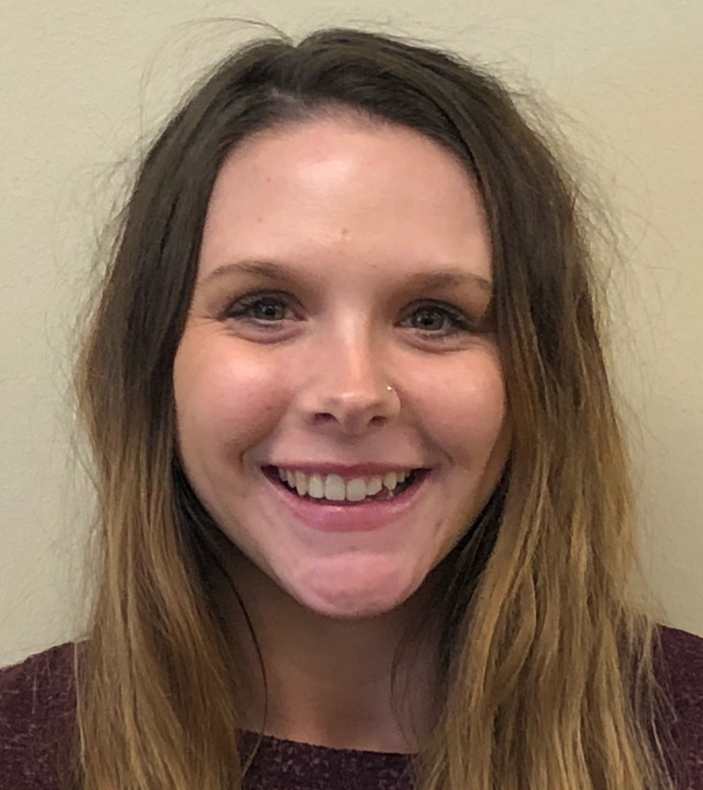
Nomination story (3rd Place) Shelli Hoffstrom-Nominated by a patient
“No matter how busy Shelli is in the moment, if you’re in crisis, need someone to talk to, or just need a warm smile, Shelli is there. Eating disorder treatment is never easy but having supportive staff like Shelli by your side helps soften the experience. Shelli was there with her kindness and her equally as needed "tough love.“ I struggled a lot during my stay at Rogers, but Shelli was always willing to talk to me, make sure my restrictions were in place for my safety, and kept a watchful eye to make sure I was okay. Shelli’s tough love in the moment was sometimes unwanted but looking back I know that it was in my best interest. Shelli never made me feel judged. Shelli is an extraordinary nurse. She treats everyone with respect and a smile. I wish I could take her home to Ohio with me but unfortunately, she has more good work to do here at Rogers. I was so blessed to be cared for by Shelli, and I know her bright affect and professionalism will bless many more to come.”
Notes:
*Please tell the nomination story, or if nominator is present, invite them to do so. [Don’t read slide text word for word]

Slide 6
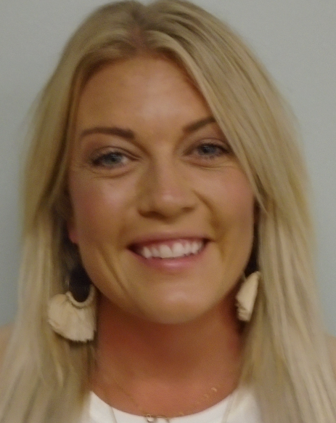
Nomination; patient story (2nd place) Cortney Kaan
"Cortney changed my life. She was with me every step of the way from admission to discharge. She was the biggest supporter as I transformed my life. With treatment came a variety of emotions. I experienced anger, anxiety, hopelessness, excitement, fear etc. Cortney was able to meet me where I was at every shift and adjust to my needs. Cortney is a talented communicator and was able to provide support and compassion to de-escalate the moment, to help me feel safe again. Her kindness will never go unnoticed. Cortney taught me to not give up on myself before trying. Fast forward.......I successfully discharged and completed IOP, but we can't forget who set me up for success, I owe it to Cortney, the RN who rooted for me the most."
Notes:
*Please tell the nomination story, or if nominator is present, invite them to do so. [Don’t read slide text word for word]

Slide 7
Nomination; patient’s own words : WINNER! Sommer Lovett- Hinsdale, Illinois PHP/IOP
"If it is worth anything, this nomination comes from someone who works in the healthcare field. When I first arrived to Rogers I was terrified. I was worried for my future and worried about what others would think of me. I was in a horrible mental state and completely withdrawn. I couldn't stop crying and I could barely look at anyone. Until I met my nurse, Sommer. She immediately met me with kindness and warmth. I knew she could tell I was scared. We walked back to a private room and she talked to me like a HUMAN being. She made me feel at ease and I was able to connect with her immediately. Her empathy allowed me to take my first deep breath in over a month. Sommer took things slow with me and made me feel as comfortable as possible on my first day at Rogers. But it didn't stop there. She helped me with terrifying exposure therapies and checked in on me regularly. Near the end of my program, we would often joke and laugh together in the hallways which helped me feel normal again. Any nurse could have just written me off and rolled their eyes at my irrational fears. Sommer showed she cared and that she understood I was in terrible pain. I will never forget how she made me feel. I wish everyone had a Sommer as their nurse. Sommer helped me change my life."
Notes:
*Please tell the nomination story, or if nominator is present, invite them to do so. [Don’t read slide text word for word]

Slide 8
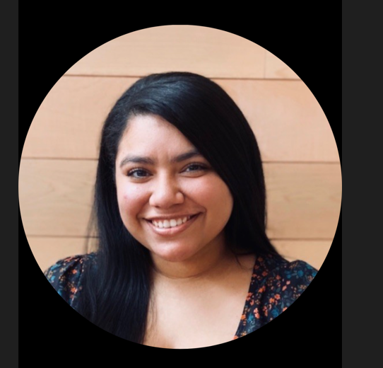
Congratulations!
Sommer Lovett- Hinsdale Illinois PHP/IOP programs.
Notes:
*After you share the name, you may wish to stop sharing your screen and encourage everyone to clap or celebrate the Honoree!

Slide 10
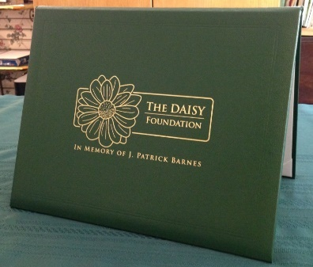
Portfolio and award pin
Notes:
Your certificate is placed in the green DAISY Foundation portfolio for you. You also have received a special DAISY Honoree pin for your badge. The pin was created because while Patrick was ill, his Stepmother, Bonnie, noticed the great tradition nurses have for pins. The DAISY Foundation hopes you will wear your DAISY Honoree Pin proudly

Slide 11
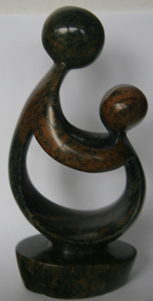
“Healer’s Touch” sculpture
Hand carved in Zimbabwe!
Artists’ video on DAISY website to learn more:
DAISYfoundation.org
Notes:
*If the Honoree has received their gifts, you may want to stop sharing your screen and allow the honoree to hold up the sculpture as you explain its meaning.
The DAISY foundation wants you to have this sculpture as a symbol of your recognition today. It is called A Healer’s Touch. Each piece is hand carved by the artists of the Shona Tribe in Zimbabwe. The DAISY Foundation chose this beautiful design not only because it sensitively depicts the unique relationship nurses have with their patients and teachers have with their students, but also because the Shona people hold their healers in a position of great importance to the community and feel about their traditional healers the way The DAISY Foundation feels about nurses and those who education them: they are treasures to their community. As you may know, the economy and politics of Zimbabwe have been in turmoil for decades, and the artists are able to support hundreds of people in their families with this work.

Slide 12
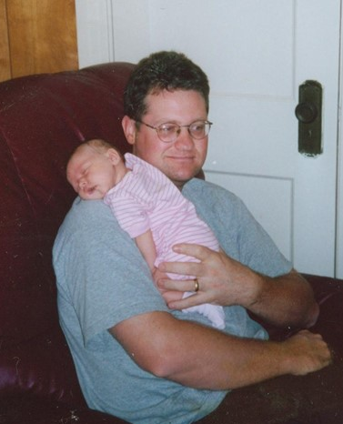
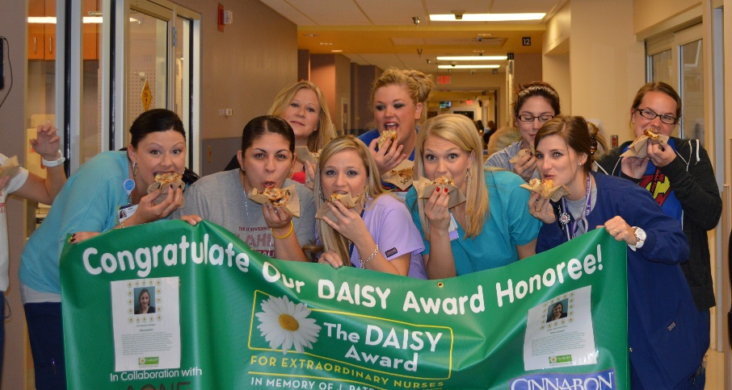
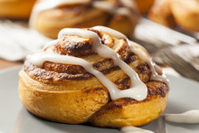
Cinnamon rolls
Notes:
*Explain how cinnamon rolls will be provided to the honoree's unit
*Share the message from DAISY about why we have cinnamon rolls at every presentation:
There are several reasons why The DAISY Foundation asks that cinnamon rolls be served at DAISY celebrations. First, when Pat was ill, he had lost his appetite until one morning, when he asked for a bite of a cinnamon roll that his Dad had brought for his own breakfast. Pat ended up eating the whole thing! As his family was leaving that evening, Pat asked that they bring him a cinnamon roll the next day and to be sure to bring in enough for all his nurses. Those cinnamon rolls were Pat’s ‘thank you’ to his nurses, and the Foundation wants all nurses to share in his favorite treat as a gift of gratitude. Secondly, nursing is a real ‘team sport,’ the cinnamon rolls serve to celebrate your team and give you an opportunity to stop for a few minutes and share something special together.
Finally, almost without exception, when a nurse receives The DAISY Award, the humble response is, ‘I didn’t do anything special. I was just doing my job.’ What the DAISY Nurse may not realize, however, is that when nurses are ‘just doing their jobs,’ they have such an important and meaningful impact on the lives of so many. DAISY hopes that whenever you smell or taste a cinnamon roll or bake with cinnamon you will be reminded how special you are and the positive difference you are making in a patient’s and/or their family’s life. You are making the world a better place because you are a nurse, and we and The DAISY Foundation both salute you and honor you.

Slide 13
Banner
The DAISY banner will be hung on your unit until the next celebration takes place
Notes:
*if you have any special traditions with your banner, like having the Honoree sign it or putting up their name and story, let them know!

Slide 14
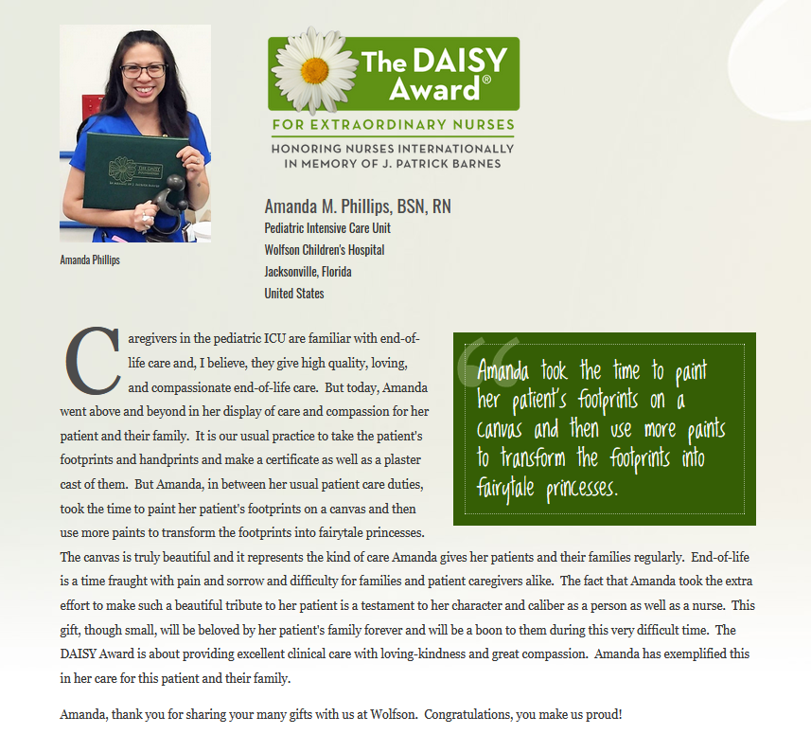
Online spotlight
You will be registered with The DAISY Foundation on their website. A special page will be created for you to share with your friends and family.
A list of your additional benefits can be found in your gift bag, or online at DAISYfoundation.org
Notes:
*Read Slide
*Invite the honoree to send in a picture for their online spotlight
*let them know if you will be sharing their story on social media, in the facility, etc.

Slide 15
Thank you
Thank you to all our patients and staff who have taken the time to nominate a nurse for their compassionate and extraordinary care that they deliver. This award does not happen unless people take the time to submit a nomination story, and it means a great deal that you care enough to do so.
Our next ceremony will be in July.
Notes:
Thank the Nominator (if present) - if not, delete slide. [Don’t read slide text word for word]

Slide 16
Conclusion
Thank you to all nurses on the Rogers team for choosing nursing as a career. Thank you for the skill, care and compassion you give to your patients every day.
Thank you for helping to make a difference in one of our patient’s or residents' lives.
Notes:
*Read slide then ask the Honoree if they would like to share a few words. If so, stop sharing your screen so everyone can see her/him.

